Slide 1




Employee Data Analysis using Excel
STUDENT NAME: S.GOKUL REGISTER NO: 122203234 DEPARTMENT:BCOM CS
COLLEGE: ST THOMAS COLLEGE OF ARTS AND SCIENCE
1

Slide 2



PROJECT TITLE
Employee Performance Analysis using Excel
2

Slide 3



AGENDA
1.Problem Statement 2.Project Overview 3.End Users
Our Solution and Proposition
Dataset Description 6.Modelling Approach 7.Results and Discussion 8.Conclusion
3/21/2024 Annual Review
3

Slide 4

PROBLEM STATEMENT
Analysing employee performance to track their working skills and to motivate the low level employees by various tasks .
To track the performance and give rewards to improve the current performance.
4

Slide 5

PROJECT
OVERVIEW
.
▪In this project we known about the employees how they perform by various graph and pivot table
▪Employee performance analysis is important to identify the performance level toward the project and improve their level by assigning new taks to emerge themselves .
5

Slide 6

WHO ARE THE END USERS?
▪Employees
▪Organisations
▪Employers
6

Slide 7


OUR SOLUTION AND ITS VALUE PROPOSITION
Filtering – remove missing
Charts - visualization repots
Pivot tabe – summary
Conditional formatting – identify missing
Formula - performance level
7

Slide 8
Dataset Description
Employee data set - the employee datas are taken from the Kaggle to analysis employe performance
9 features
Employee ID: Unique identifier for each employee in the organization. First Name: The first name of the employee.
Title: The job title or position of the employee within the organization
.
.Business Unit: The specific business unit or department to which the employee belongs.
Employee Status: The current employment status of the employee (e.g., Active, On Leave, Terminated). Employee Type: The type of employment the employee has (e.g., Full-time, Part-time, Contract).

Slide 9

THE "WOW" IN OUR SOLUTION
•=IFS(Z30>=5,"VERY HIGH",Z30>=4"HIGH",Z30>=3"MED","TRUE","LOW"
3/21/2024 Annual Review
9

Slide 10


MODELLING
Data collection
The employee performance analysis table are taken from the website called Kaggle .
From the data we had some missing figures to identify the missing terms we use conditional techniques to identify the missing terms like exit data etc..
Then we used filtering and sorting to fill the missing figues
Features collection
Pivot table Charts
Conditional formatting
10

Slide 11
Pivot table
Click insert
From the insert bar click pivot table in new excel sheet 3.Select business unit and drag it in row
4.Then select performance level and drag it in column
5 . Select gender in value
Performance level
From the pivot table we can see the analysis for female male and all and we can access all type of employees by inerting slicers to see how many are full time ,part time and contract based employees.
Insert graph for better analysis the graph shows the accurate levels and the performance of employees. We can see the various graph by changing the options in the graph options.

Slide 12
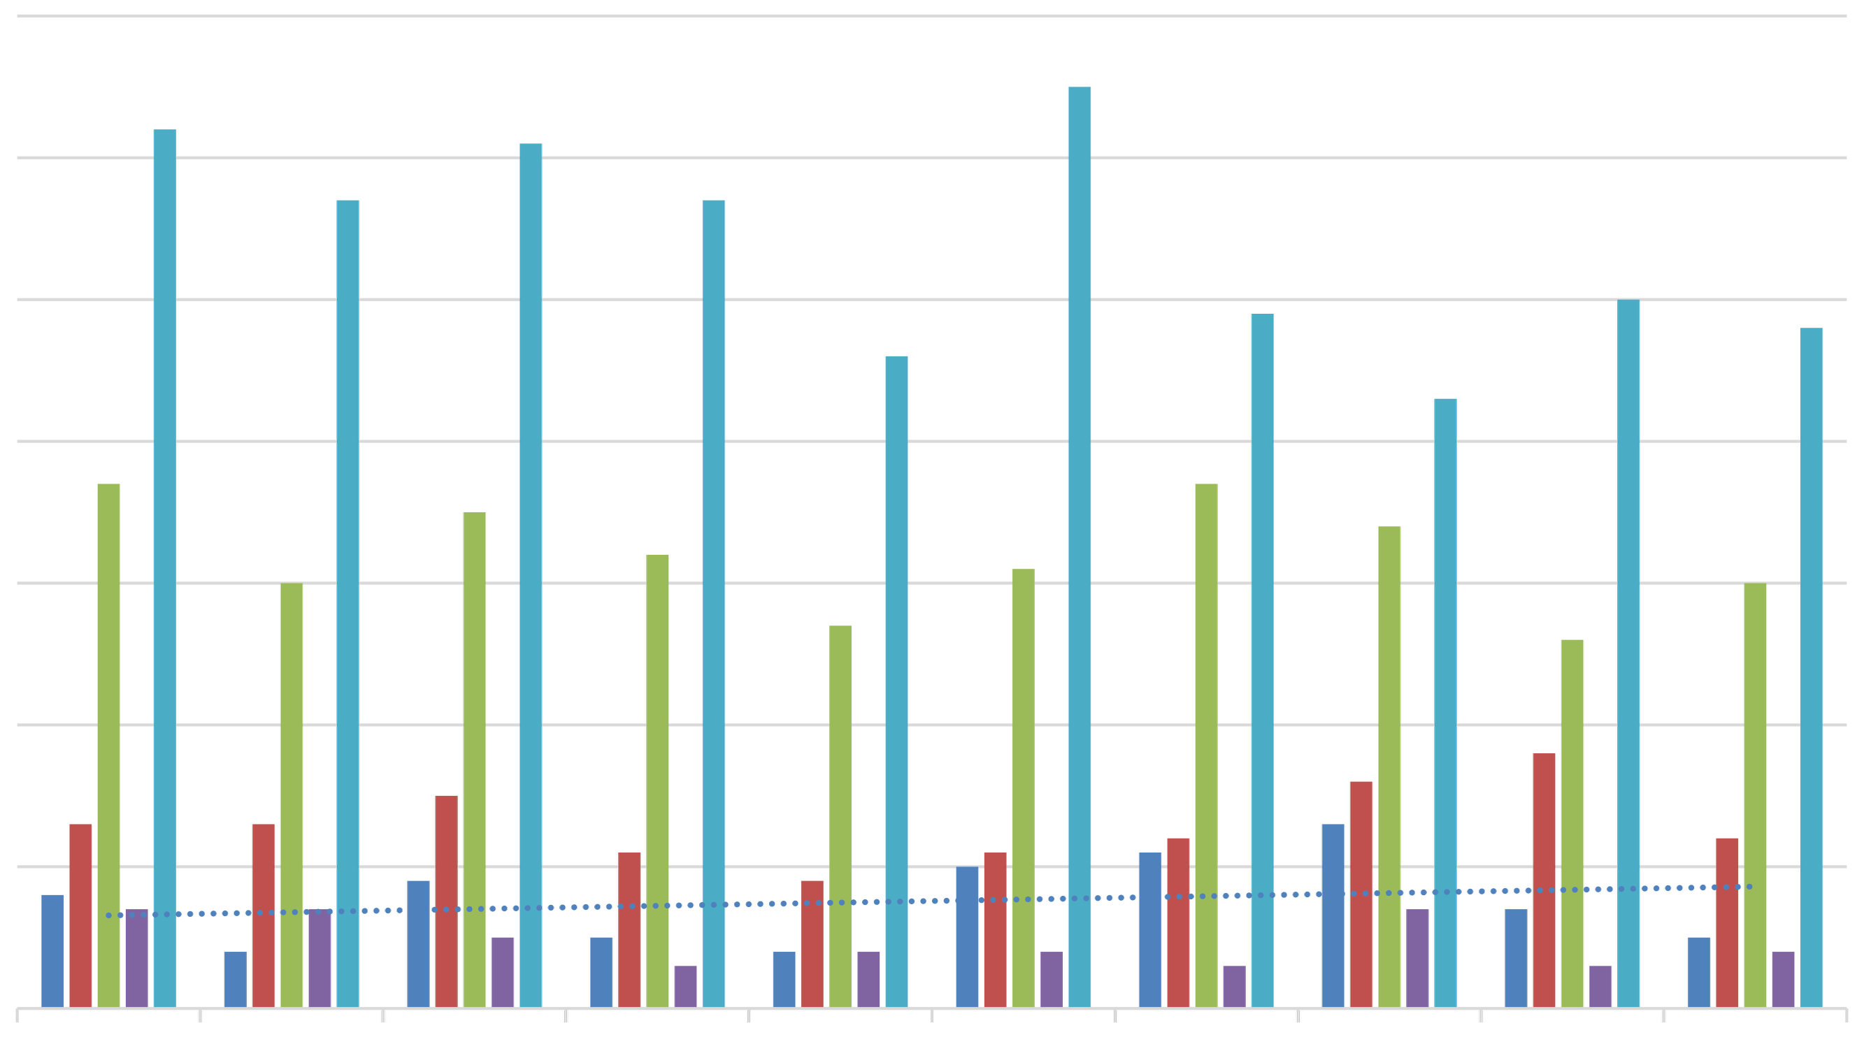
RESULT
S
EMPLOYEE PERFORMANCE ANALYSIS
70
60
50
HIGH LOW MED VERY HIGH
(blank)
40
30
Linear(HIGH)
20
10
0
BPC
CCDR
EW
MSC
NEL
PL
PYZ
SVG
TNS
WBL
12

Slide 13

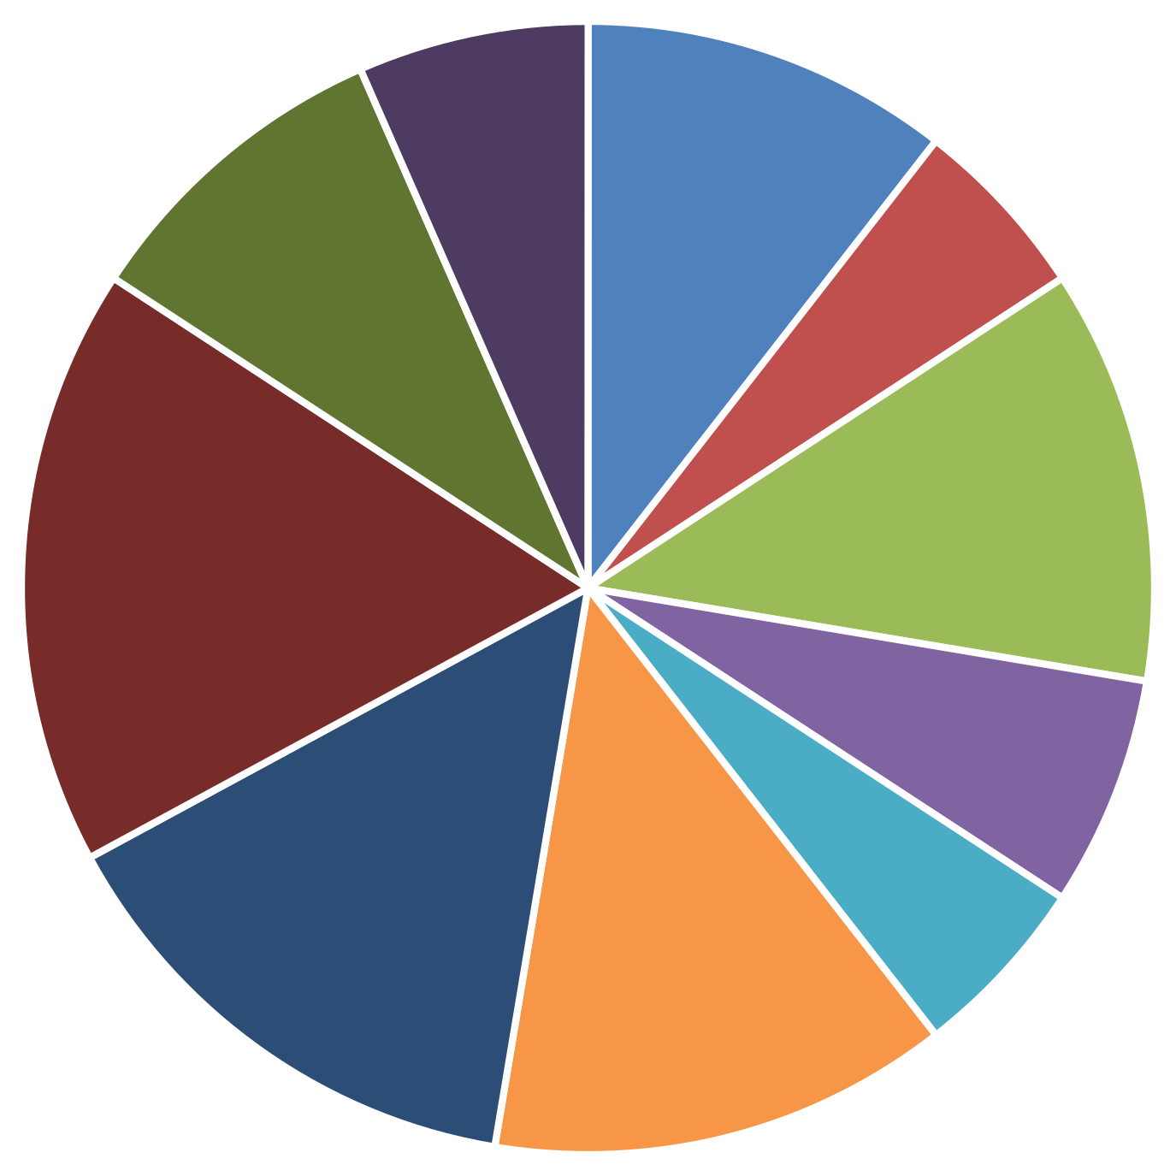
Pie chart for high level performance
HIGH
BPC CCDR EW MSC NEL PL PYZ SVG TNS WBL

Slide 14
conclusion
From the above analysis the low level,medium level to be improved by assigning various tasks and training in their field
The current high and very high level employees are improve their intensity by rewards and appreciations towards their growth to increase their participation and to give more potential towards their project.

